Slide 1
Agile Processes
Dirk Riehle, Univ. Erlangen
AMOS B03
Licensed under CC BY 4.0 International

Slide 2
Agenda
Software development
Plan-driven development
Agile methods
Scrum

Slide 3
1. Software Development

Slide 4
Products vs. Projects
Products have a life-cycle; may live forever
Products are developed for a market (many customers)
Projects have a defined start and end date
Projects are developed for one client (one customer)

Slide 5
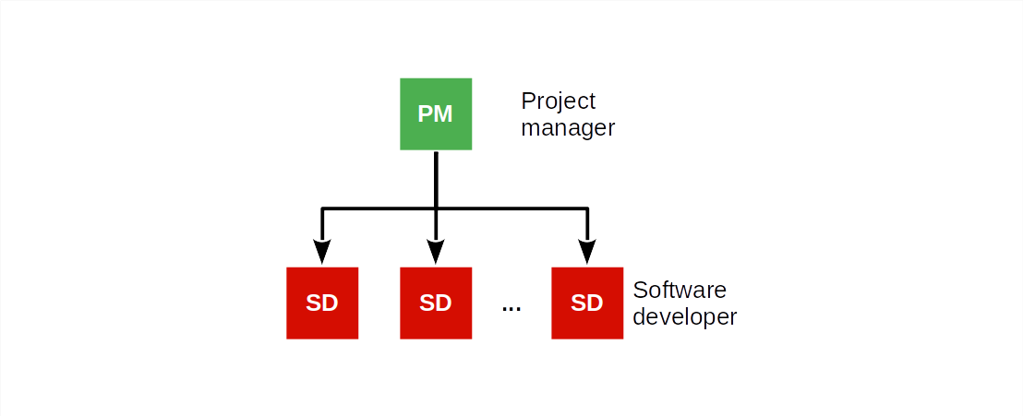
Traditional Software Project Organization (Consulting Firm)

Slide 6
Job Descriptions in Software Consulting Pojects
A project manager is responsible for
Planning, managing, and delivering the project results to clients
A software developer is responsible for
Implementing the functionality as requested by the project manager

Slide 7
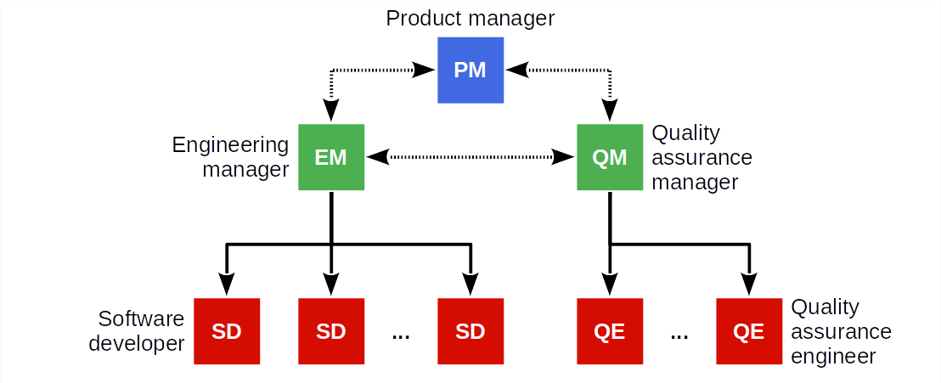
Traditional Software Product Organization (Vendor)

Slide 8
Job Descriptions in Software Product Development
A product manager is responsible for
What needs doing
An engineering manager is responsible for
Who gets to do it and when
A software developer is responsible for
How it gets done and how long it will take
Quality assurance is responsible for
Ensuring that the product meets the expectations

Slide 9
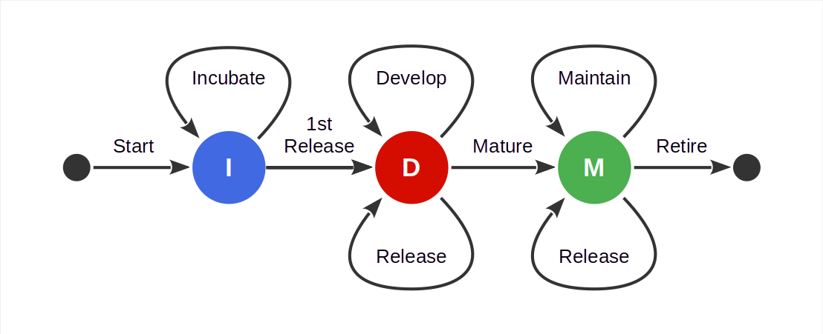
Basic Software Product Life-Cycle

Slide 10

The Magic Triangle (“Pick Two”)

Slide 11
2. Plan-Driven Development

Slide 12
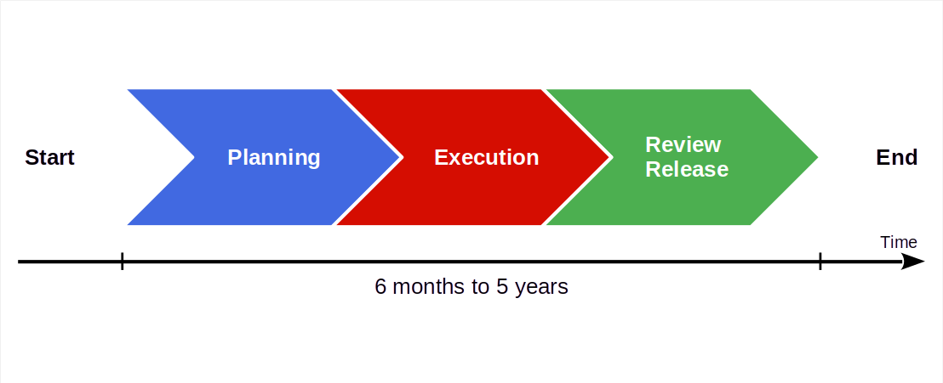
Basic Plan-Driven Development

Slide 13

Video From “The Pentagon Wars” [1]
[1] See https://youtu.be/r0op8e0LuoU

Slide 14
Video Lessons
Stakeholders problems
Multiple stakeholders with conflicting interests
Meddling stakeholders intervening into the process
Requirement problems
Inconsistent requirements (poor quality assurance)
Changing requirements (wandering focus, long project)
Feature creep (from troop carrier to tank)
Product problems
Cost explosion due to lack of focus, rework
Unclear market and wandering purpose

Slide 15
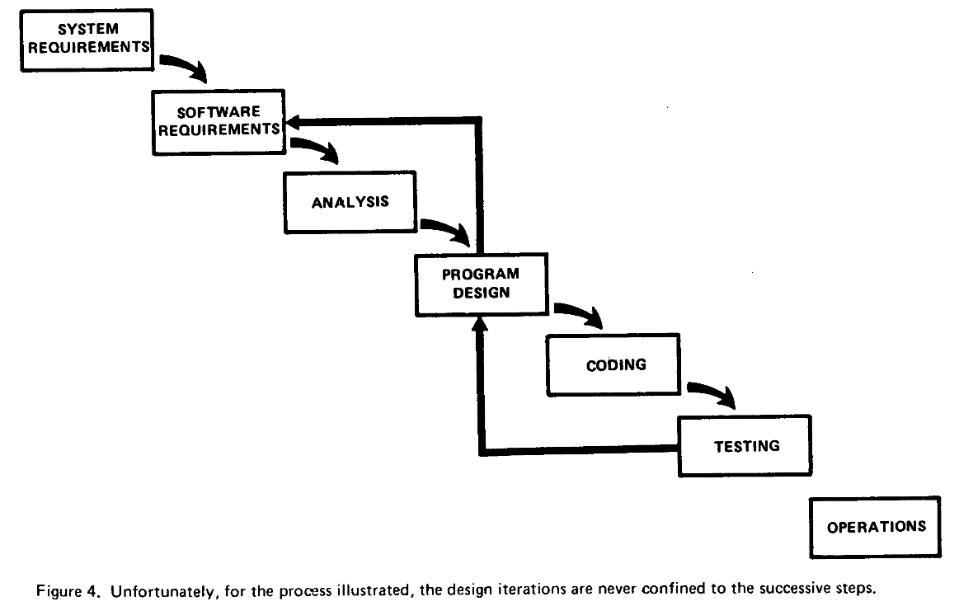
The Waterfall Model [1]
[1] Royce, W. W. (1970). Managing the development of large software systems. Proceedings of IEEE WESCON. Los Angeles, 328-388.

Slide 16
Main Lesson From Plan-Driven Development
Phases ≠ Activities

Slide 17
3. Agile Methods

Slide 18
Agile Methods
Agile methods are a category of software development methodologies
Defined in opposition to plan-driven development
Driven by consultants as a significant business opportunity
The key idea of agile methods is to have a fast feedback loop
Steer, don’t plan and blindly execute
Codified as the agile manifesto
Examples agile methodologies
Scrum, XP, the Crystal Methods, Feature Driven Development

Slide 19
Principles of the Agile Manifesto [1]
Individuals and interactions
Over processes and tools
Working software
Over comprehensive documentation
Customer collaboration
Over contract negotiation
Responding to change
Over following a plan
[1] See https://agilemanifesto.org

Slide 20
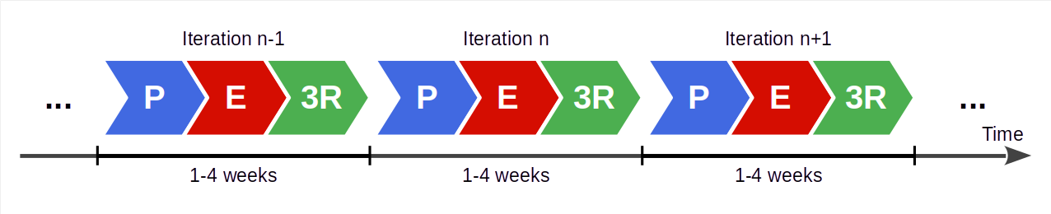
Agile Development Process
Succession of equal-length iterations (“time-boxes”, “sprints”)
Intervention points are during planning and review
User feedback only available during review
P = Planning
E = Execution
3R = Review, release, and retrospective

Slide 21
Benefits of Fast Feedback Loops
Short iterations
Short iterations lead to focus on high-value features first
Established well-worn rhythm is sustainable, avoids burnout
Partial functionality is better than none
User feedback
User feedback helps team steer product to meeting needs right
Feedback loop ensures that problems surface early
Feedback helps recognize and realize new innovative features

Slide 22
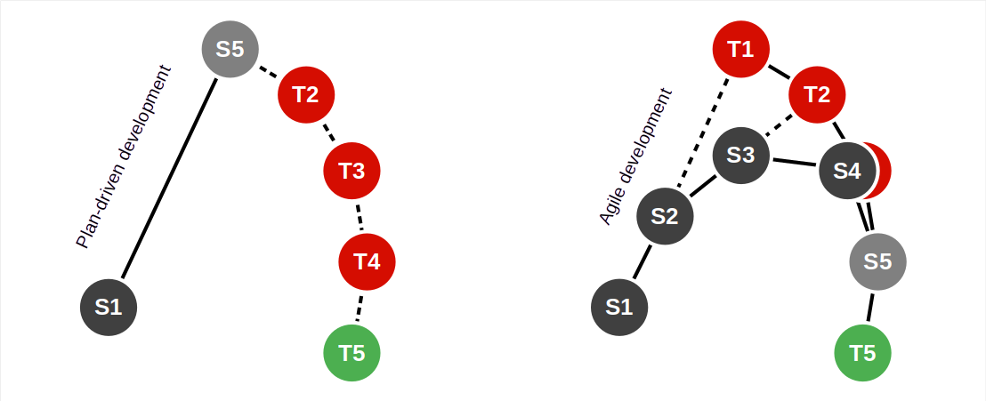
Plan-Driven vs. Agile Processes

Slide 23
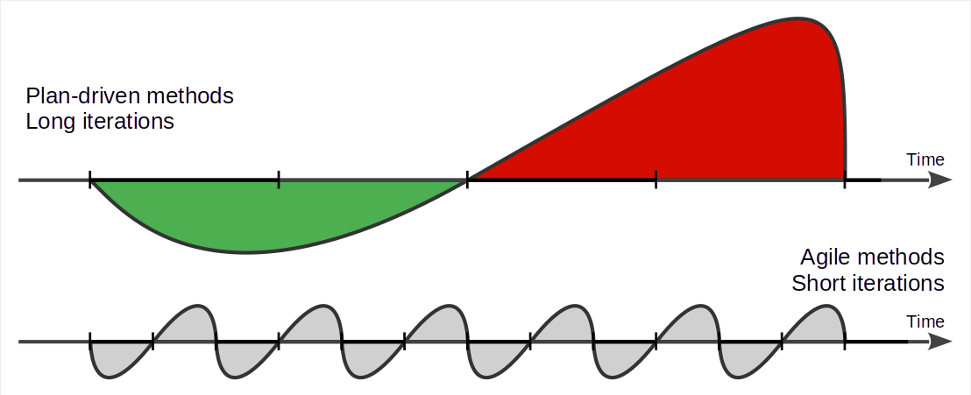
Plan-Driven vs. Agile Work Rhythms

Slide 24
Do Agile Methods Lead to Cowboy Coding?
Agile methods are high discipline

Slide 25
4. Scrum

Slide 26
Scrum [1]
Scrum is an agile method (framework) invented around 1993, 1995
Has a minimal (agile) process model
Is applicable to any domain, not just software development
[1] Schwaber, K., & Sutherland, J. (2020). The scrum guide. Web-published.

Slide 27
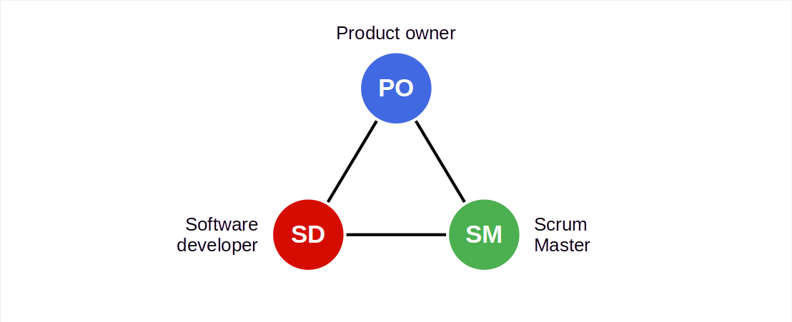
Scrum Roles / Scrum Team [1]
[1] The Scrum team is one Scrum Master, one product owner, software developers

Slide 28
Committed vs. Involved Roles
Committed roles
Product owner
Software developer(s)
Scrum Master
Involved roles
Customer
Sponsor / funder
Regulators
…

Slide 29
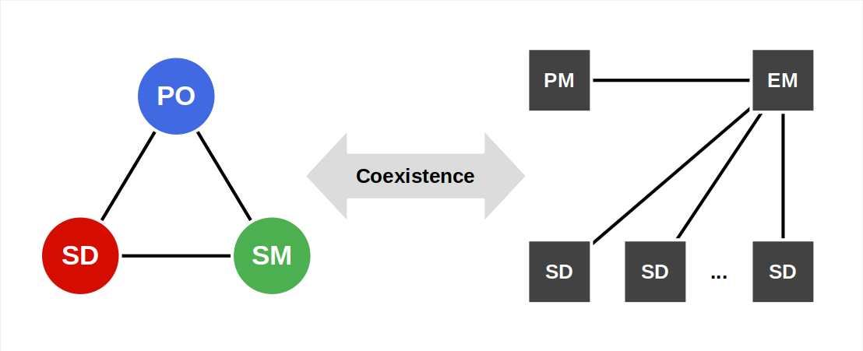
Mapping Roles to Posts

Slide 30
Roles / Posts Correspondence
Custom projects |  | Scrum |  | Products for a market
Project manager | → | Product owner | ← | Product manager Engineering manager
Project manager Software developer | → | Software developer | ← | Software developer Engineering manager Quality assurer
Project manager | → | Scrum Master | ← | Engineering manager

Slide 31
Terms (The Scrum Terminology Mess)
Scrum | Product development | Project implementation
Product owner | Product manager | Business analyst, Requirements engineer
Product goal | Product vision [1] | Project mission [1]
Product backlog | Product requirements document (PRD) | Requirements specification
[1] This resolution is specific to AMOS, though the terms are generally known and used

Slide 32
Scrum Scope / Time Horizons
Scrum proper covers
Day
Sprint (weeks)
Releases (months)
Project/product (years)
Further evolutions e.g. SAFe cover
Product life-cycle (years)
Portfolio

Slide 33
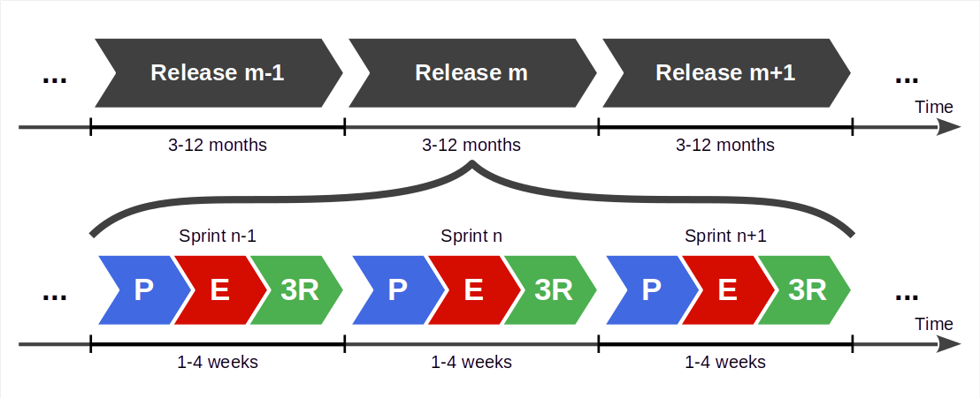
Scrum Process

Slide 34
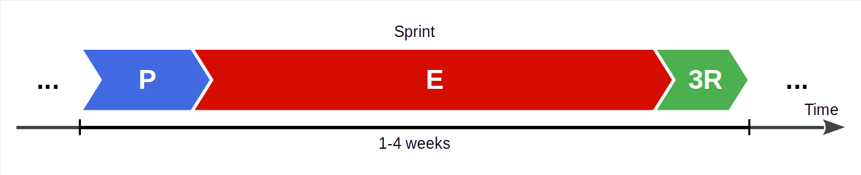
Scrum Sprint
A sprint is Scrum’s iteration; it is an equal-length time-box
It is a highly structured process with defined feedback points

Slide 35
Increment of Value
An increment of value is
Some added value to current or new artifacts
Increments of value are mainly provided by
Sprints (via sprint release)
Basically, anything that has a definition of done

Slide 36
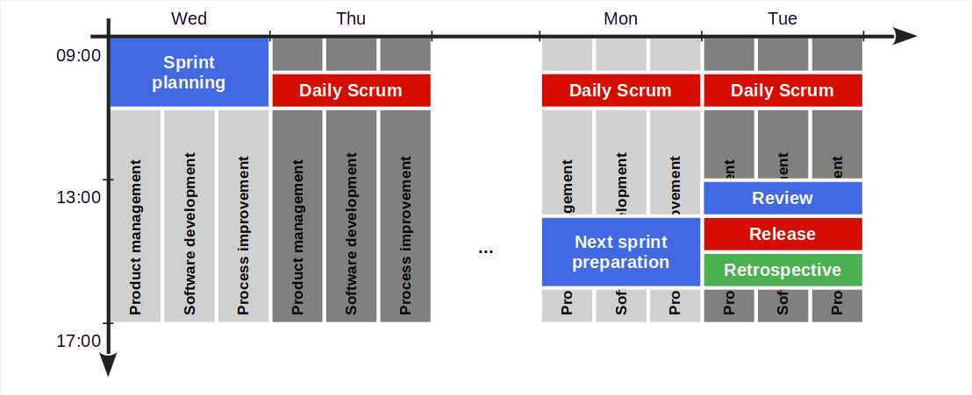
Sprint Structure

Slide 37
Sprint Meetings
The AMOS
team meeting
Next sprint preparation
Product owner and senior developer groom the product backlog
Sprint review
Team reviews this sprint’s results, signs off on them
Sprint release
Team decides on sprint release
Sprint retrospective
Team reviews process, commits to improvements
Sprint planning
Team discusses upcoming work, commits to it
Daily Scrum
Team members update each other on work progress

Slide 38
Sprint Workstreams
Product management; the product owner
Builds and grooms the product backlog
Answers questions to developers
Software development; software developers
Break down backlog items into tasks, self-organize
Design and implement sprint backlog items
Process improvement; the Scrum Master
Observes problems and opportunities
Facilitates impediments resolution and improvements

Slide 39
Summary
Software development
Plan-driven development
Agile methods
Scrum

Slide 40
Thank you! Any questions?
dirk.riehle@fau.de – https://oss.cs.fau.de
dirk@riehle.org – https://dirkriehle.com – @dirkriehle

Slide 41
Legal Notices
License
Licensed under the CC BY 4.0 International license
Copyright
© Copyright 2023 Dirk Riehle, some rights reserved

Slide 42
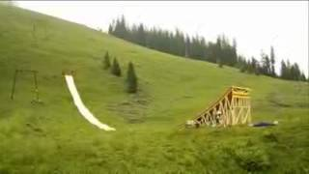
Megawoosh! [1]
[1] See https://www.youtube.com/watch?v=D7rbiLNf-JI

Slide 43

Video Lessons [1]
[1] See https://youtu.be/_n065KE00J0

